Slide 1


Capstone Project Seoul Bike Sharing Demand Prediction
Team Members Chetan Patil
Mrunal Badgujar
Sachin Chaudhari
Rajesh Patil

Slide 2

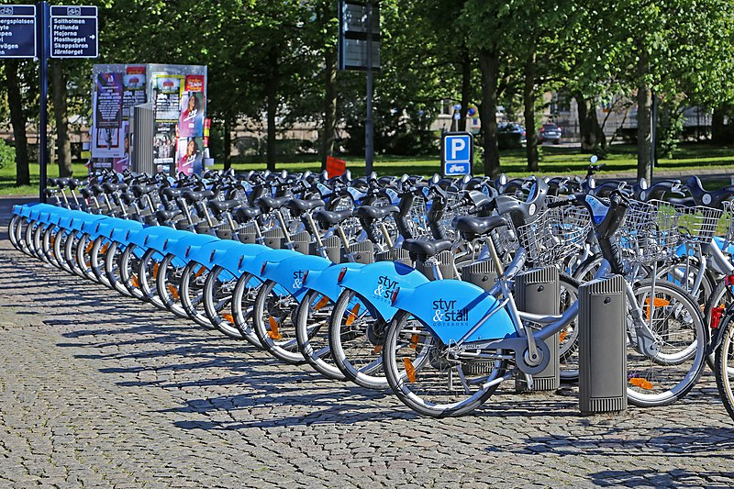
PROBLEM DESCRIPTION:
Currently Rental bikes are introduced in many urban cities for the enhancement of mobility comfort. It is important to make the rental bike available and accessible to the public at the right time as it lessens the waiting time. Eventually, providing the city with a stable supply of rental bikes becomes a major concern. The crucial part is the prediction of bike count required at each hour for the stable supply of rental bikes.

Slide 3
BUSINESS UNDERSTANDING
Bike rentals have became a popular service in recent years and it seems people are using it more often. With relatively cheaper rates and ease of pick up and drop at own convenience is what making this business thrive.
Mostly used by people having no personal vehicles and also to avoid congested
public transport that’s why they prefer rental bikes.
Therefore, the business to strive and profit more, it has to be always ready and supply no. of bikes at different locations, to fulfill the demand.
Our project goal is a pre planned set of bike count values that can be a handy
solution to meet all demands.

Slide 4
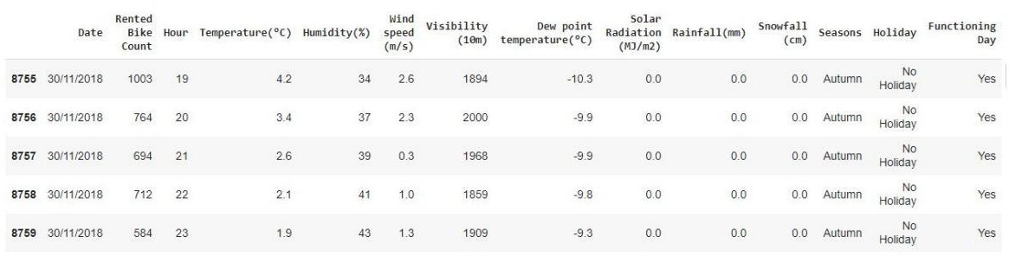
DATA SUMMARY
This Dataset contain 8760 rows and 14 columns.
Three categorical features ‘Seasons’, ‘Holiday’, & ‘Functioning Day’.
One Datetime column ‘Date’.
We have some numerical type variables such as temperature, humidity, wind, visibility, dew point temp, solar radiation, rainfall, snowfall which shows the environmental conditions for that particular hour of the day.

Slide 5
DATA SUMMARY
There are No Missing Values present
There are No Duplicate values present
There are No null values.
The Dependent Variable Is 'Rented Bike Count' Which We Need To Make Predictions On.
The dataset shows hourly rental data for one year (1 December 2017 to 31 November 2018)
We changed the name of some features for our convenience, they are as
follows Date, Rented_Bike_Count, Temperature, Humidity, Wind speed, Visibility, Dew_point_temperature, Solar_Radiation, Rainfall, Snowfall, Functioning_Day.

Slide 6
FEATURE TYPES
FEATURES
TARGET VARIABLE
NUMERIC
Temp
Humidity
Wind
dew_temp
Sunlight
Rain
Snow
CATEGORICAL
Hour
Functioning day
weekdays_weekend
BIKE COUNT

Slide 7
FEATURE SUMMARY
Date : Year-Month-Day
Rented Bike Count - Count of bikes rented at each hour
Hour - Hour of the day
Temperature - Temperature in Celsius
Humidity - %
Wind Speed - m/s
Visibility - 10m
Dew point temperature -Celsius
Solar radiation -MJ/m2
Rainfall -mm
Snowfall –cm
Seasons -Winter, Spring, Summer, Autumn
Holiday -Holiday/No Holiday
Functional Day - NoFunc(Non Functional Hrs),Fun(Functional Hrs)

Slide 8
Exploratory Data Analysis

Slide 9
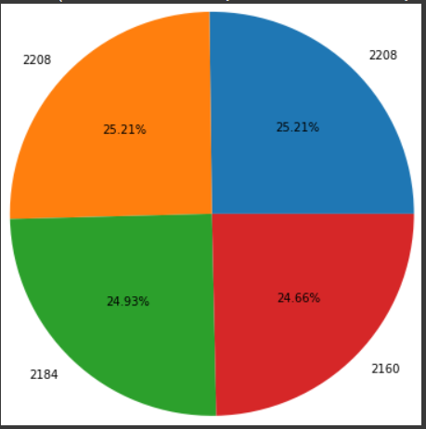
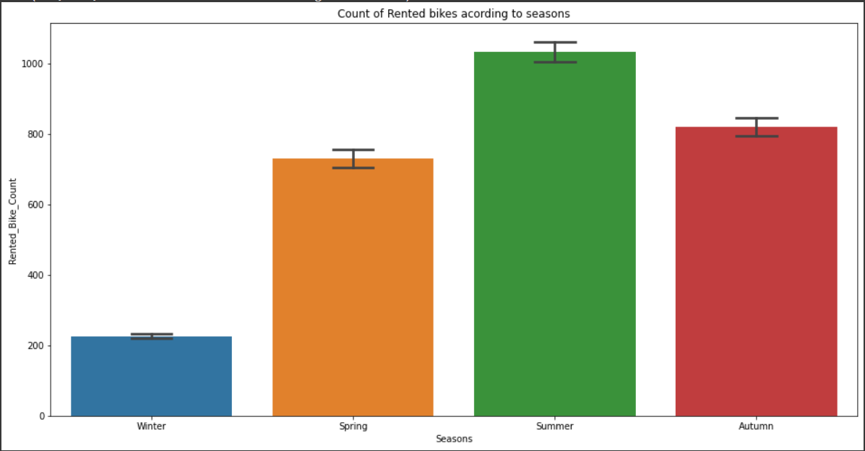
How Many Bikes Rented By Season Wise
Which Season Has Maximum Number Of Bikes Rented
As Per The Chart
Summer 25.21% of total bike rented
Winter 24.66 of total bike rented
Spring 25.21 of total bike rented
Autumn 24.93 of total bike rented
People would like to rent bike mostly in summer season followed by autumn.

Slide 10
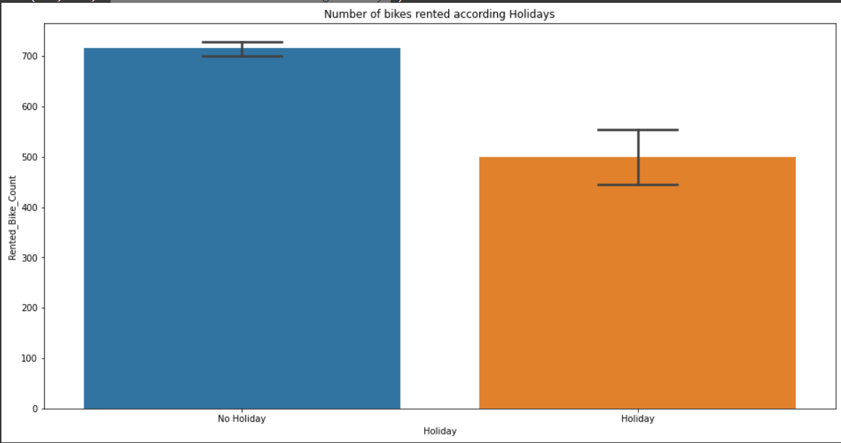
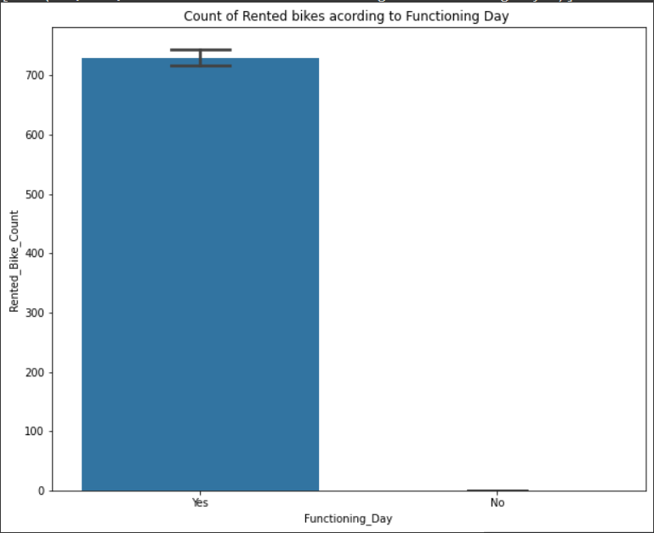
Number Of Bikes Rented According Holidays
Are people use rented bikes on functioning day
Clearly we can see maximum number of bikes rented on non holidays
As per the plots we can see peolpe like to use bikes on functioning day

Slide 11
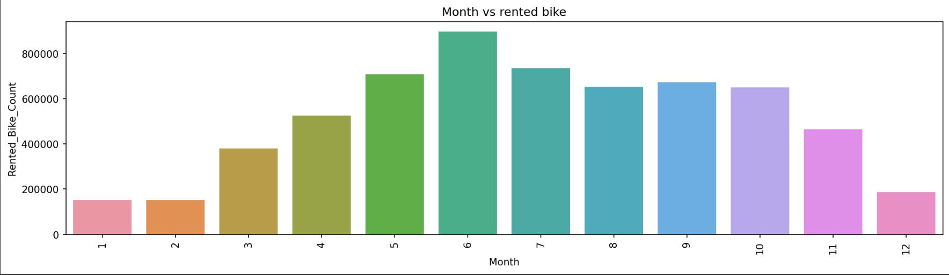
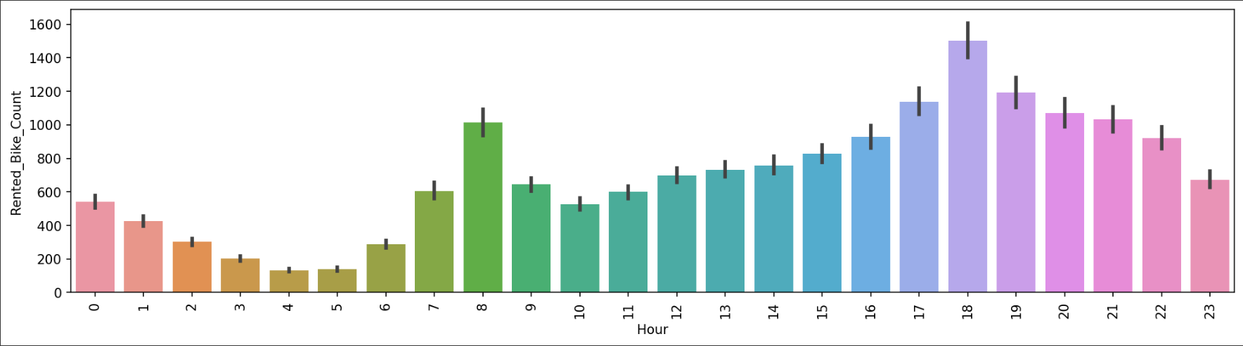
Which month have maximum number of bookings
As Per The Above Chart We Can See The June Is The Busiest Month ,Followed By July And May
how long customer would like to rent bike (in hours)
As We Can Many Customer Would Like To Rent Bike For 18 Hrs Folled By 17hrs And 19hrs

Slide 12
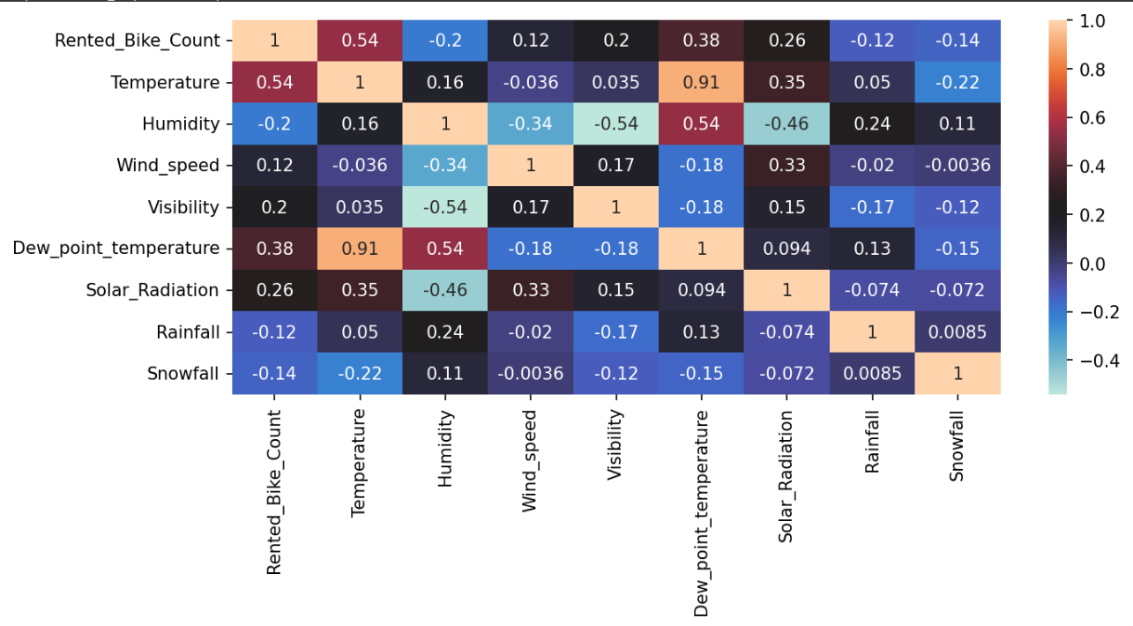
Correlation between parameters

Slide 13
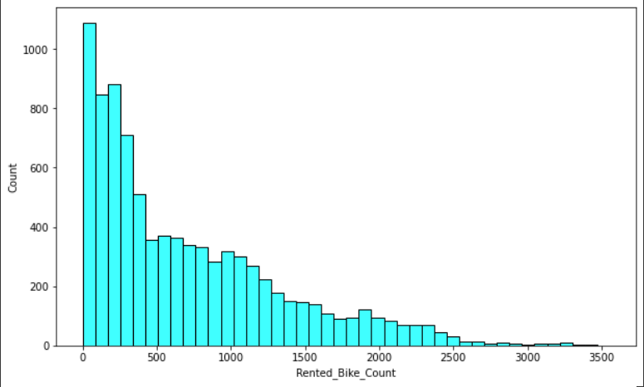
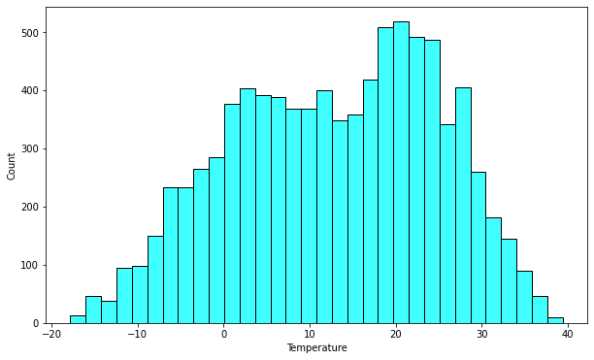
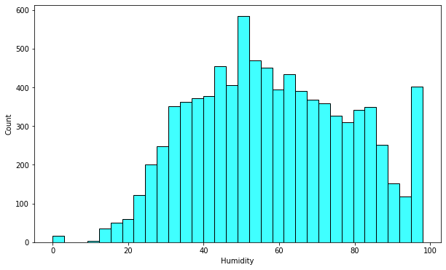
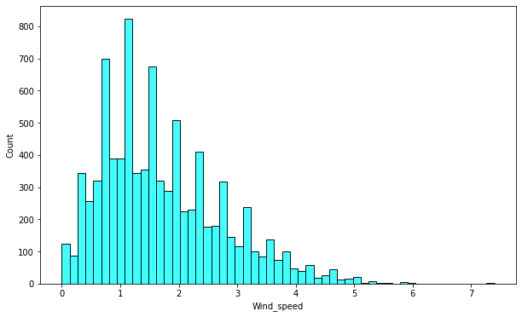
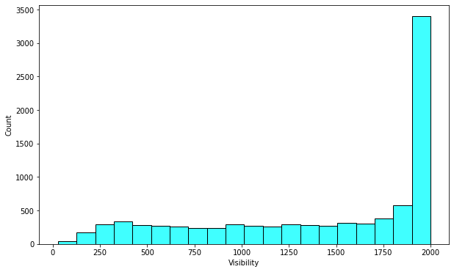
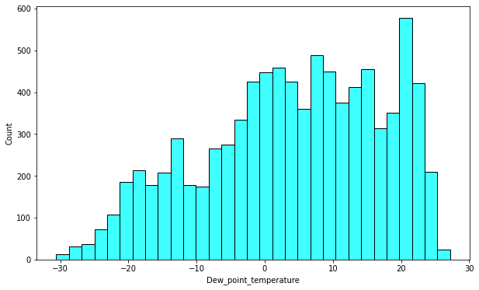
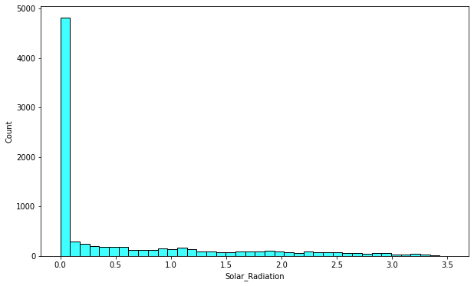
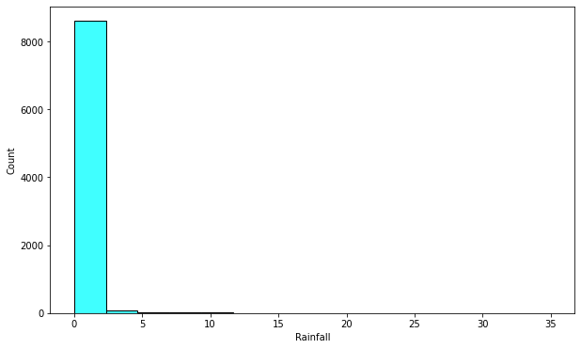
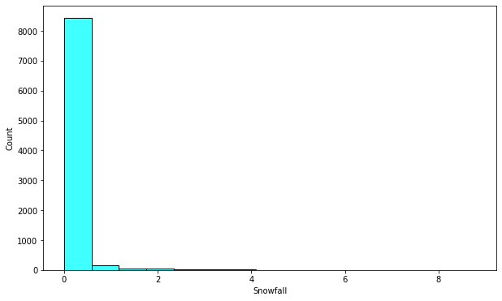
Distribution

Slide 14
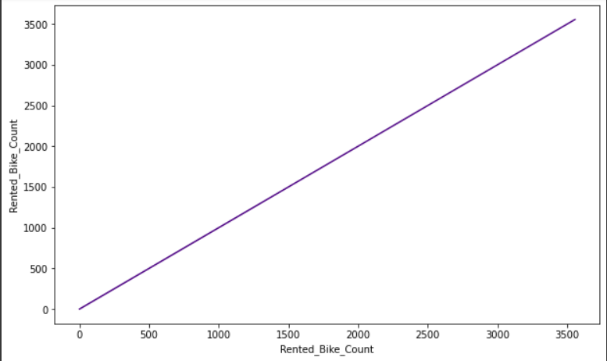
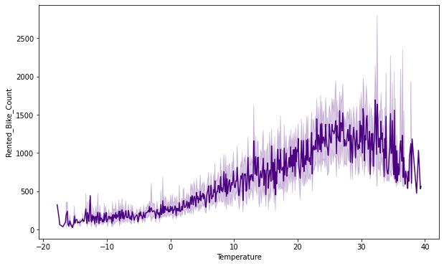
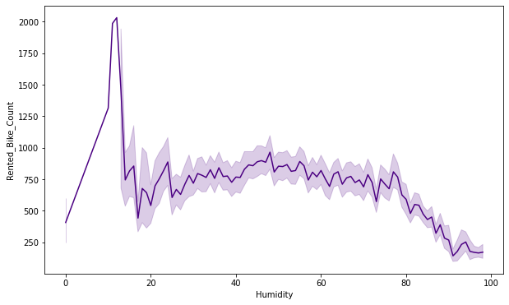
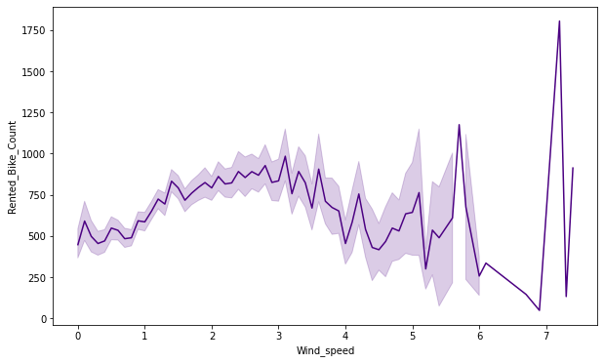
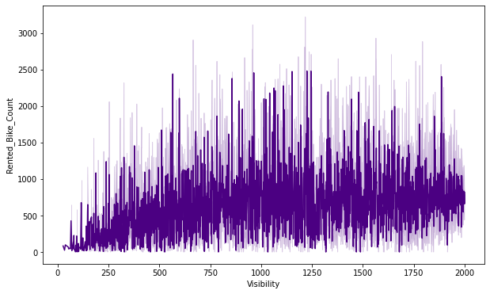
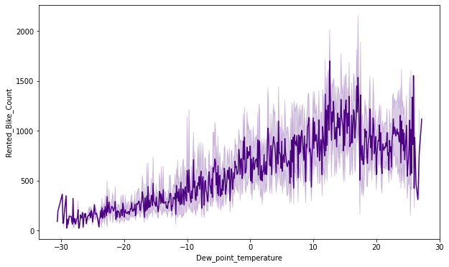
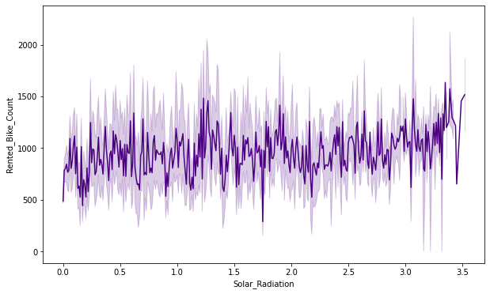
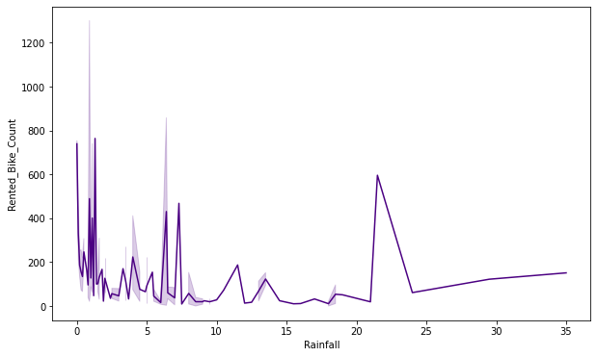
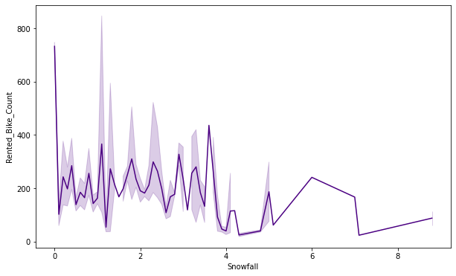
Numerical v/s rented bikes

Slide 15
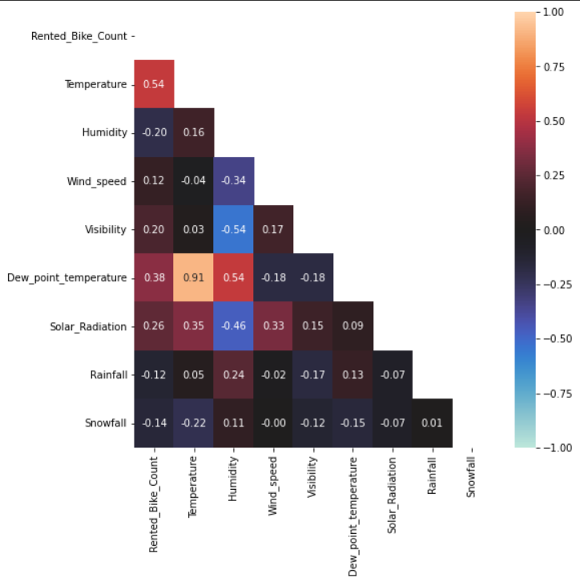
Multicollinearity analysis
From The Above Graph We Can Clearly See There Is No Strong Relation Between Rented Bikes And Other Parameters But The Temperature Is Strongly Correlated With Dew Point Temperature We Can Drop The Column It Can Not Affect On Our Data.

Slide 16
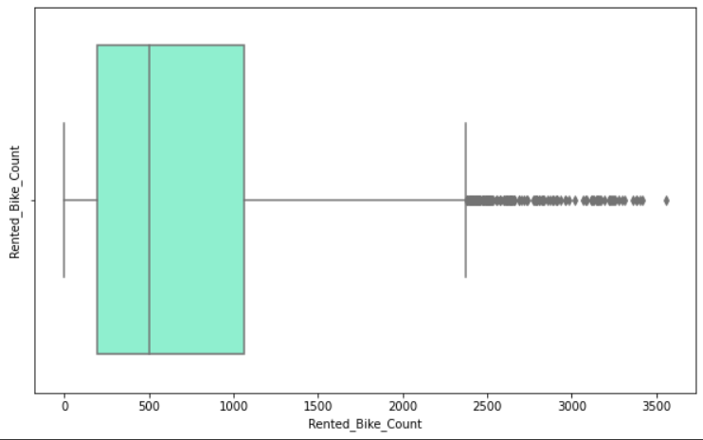
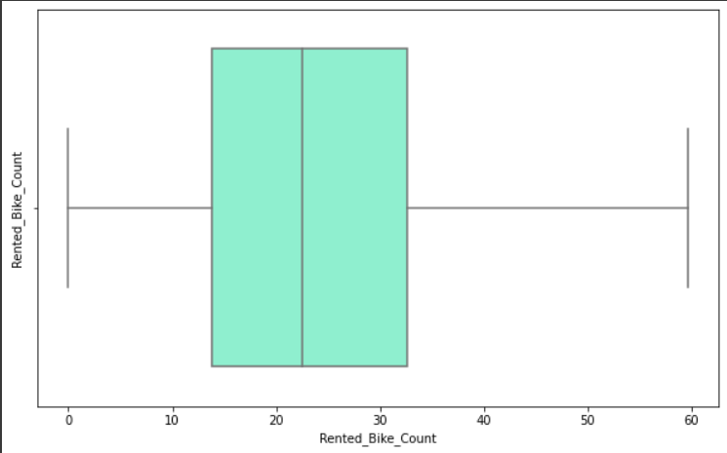
Detection and removal of outlier
As we can see outliers present in dataset so need to clean data for better results.
As we checked by using boxplot there are no outliers present in our data.

Slide 17
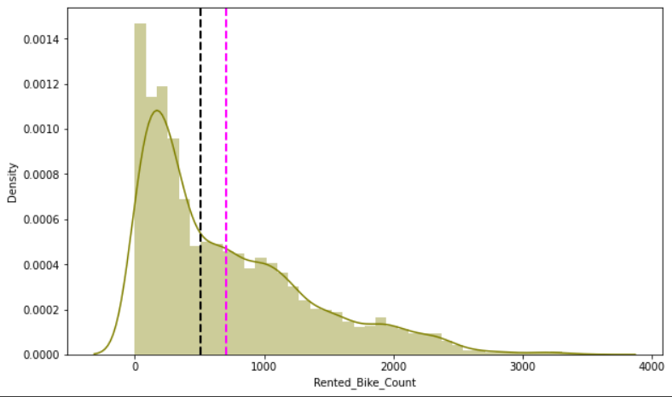
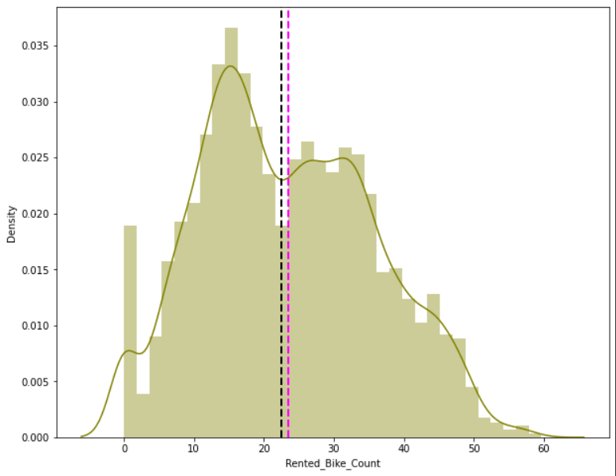
Normalise Rented Bike Count column data
The Goal Of Normalization Is To Transform Features To Be On A Similar Scale. This Improves The Performance And Training Stability Of The Model.
As We Can See Our Data Is Skewed Toward Right We Can Say Many Outliers Are Present In Our Data Need To Remove Outliers
We Can Clearly See The Outliers Are Removed And Our Data Is Normally Distributed Now(bell Curve) This Data Will Give Some Accurrate Results

Slide 18
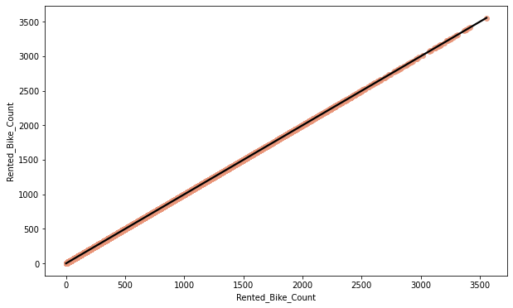
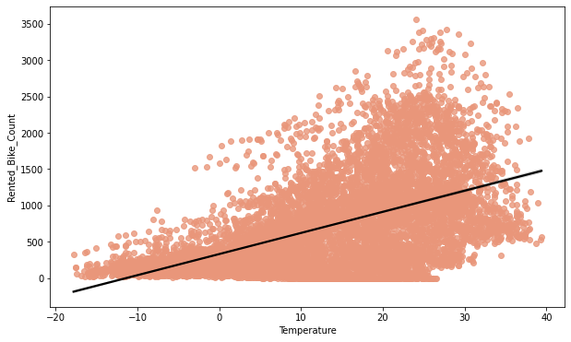
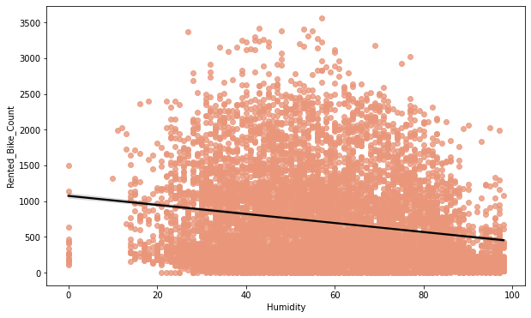
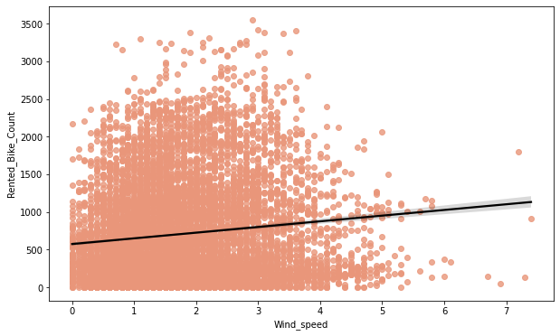
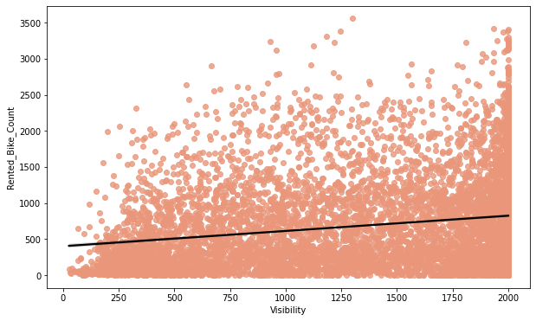
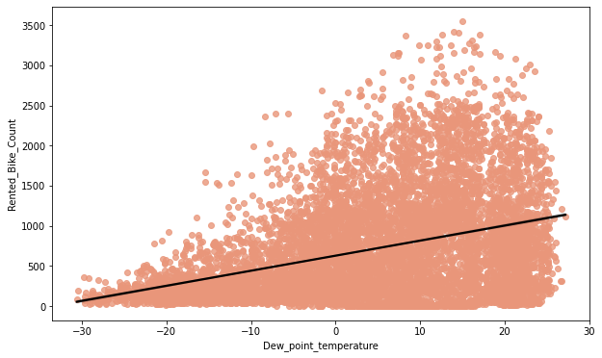
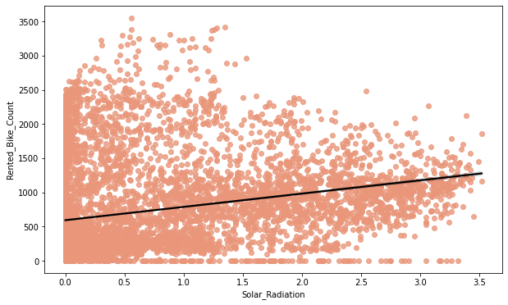
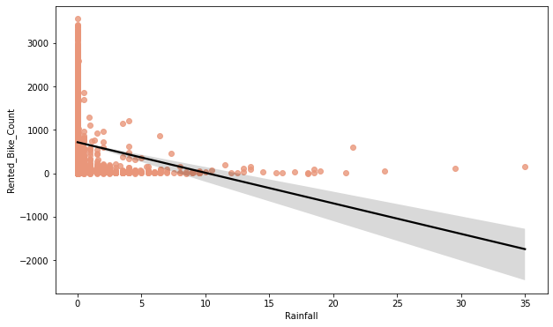
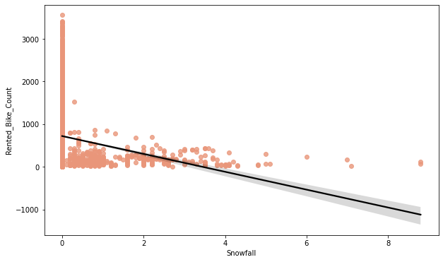
Regression Plots
Regression is a technique for investigating the relationship between independent variables or features and a dependent variable or outcome. It’s used as a method for predictive modelling in machine learning, in which an algorithm is used to predict continuous outcomes.

Slide 19
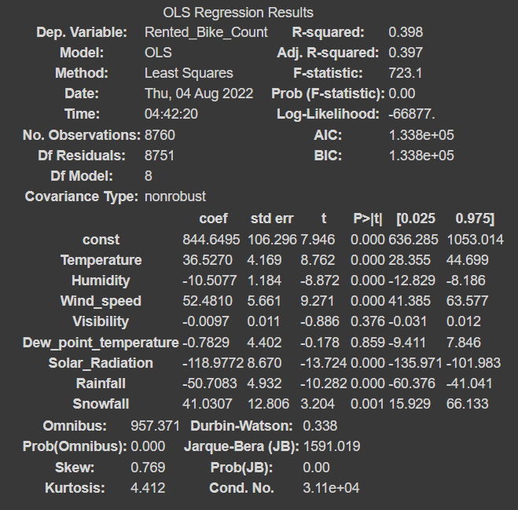
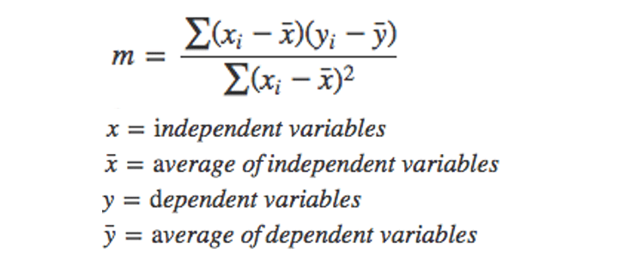
Model Building
OLS MODEL
The Basic Idea Behind Linear Regression Is To Fit A Straight Line To Our Data. We Can Do So By Using The Ordinary Least Squares (OLS) Method. In This Method, We Draw A Line Through The Data, Measure The Distance Of Each Point From The Line, Square Each Distance, And Then Add Them All Up. After A Lot Of Trial And Error, We’re Able To Find The Best Fit Line. Essentially, The Best Fit Line Covers All Of Our Data Points Such That The Distance Of Each Data Point From The Line Is Minimized. This In Turn Minimizes The Error Obtained.
From the OLS model we find that the 'Temperature' and 'Dew_point_temperature' are highly correlated so we need to drop one of them. for dropping the we check the (P>|t|) value from above table and we can see that the 'Dew_point_temperature' value is higher so we need to drop Dew_point_temperature column for clarity, we use visualisation i.e., heatmap in next step

Slide 20
List of Models
LINEAR REGRESSION
LASSO REGRESSION
RIDGE REGRESSION
ELASTIC NET REGRESSION
DECISION TREE
RANDOM FOREST
GRADIENT BOOSTING
Importance of features
Gradient Boosting Regressor

Slide 21
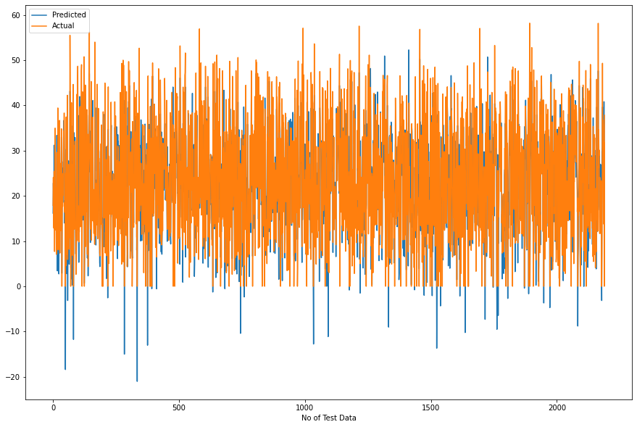
LINEAR REGRESSION
MSE: 33.27533089591926
RMSE: 5.76847734639907
MAE: 4.410178475318181
R2: 0.7893518482962683
Adjusted R2: 0.7847297833429184
Clearly See Our R2 Score Value Is 0.77 That Means Our Model Is Able To Capture Most Of The Data Variance. We Will Compare With Others For Best Fit Model.

Slide 22
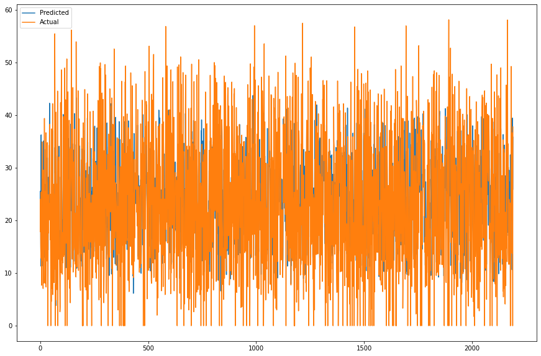
LASSO REGRESSION
MSE: 96.7750714044618
RMSE: 9.837432155011886
MAE: 7.455895061963607
R2: 0.3873692800799008
Adjusted R2: 0.37392686932535146
The R2_score For The Test Set Is 0.38. This Means Our Linear Model Is Not Performing Well On The Data. Let Us Try To Visualize Our Residuals And See If There Is Heteroscedasticity (Unequal Variance Or Scatter).

Slide 23
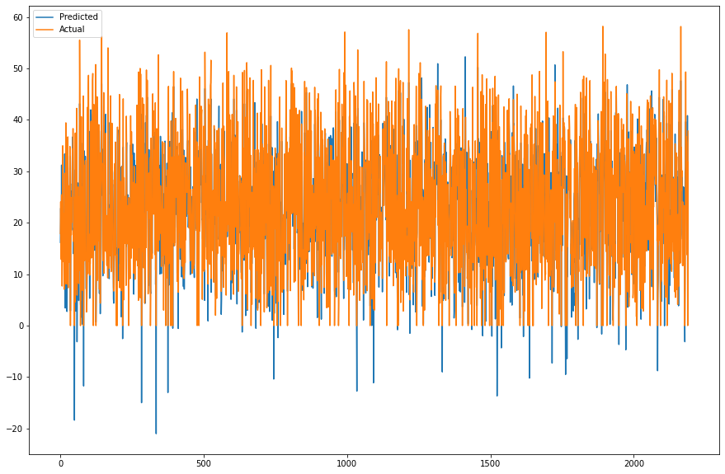
RIDGE REGRESSION
MSE: 33.27678426818438
RMSE: 5.768603320404722
MAE: 4.410414932539515
R2: 0.7893426477812578
Adjusted R2: 0.7847203809491939
Clearly See Our R2 Score Value Is 0.78 That Means Our Model Is Able To Capture Most Of The Data Variance. We Will Compare With Others For Best Fit Model

Slide 24
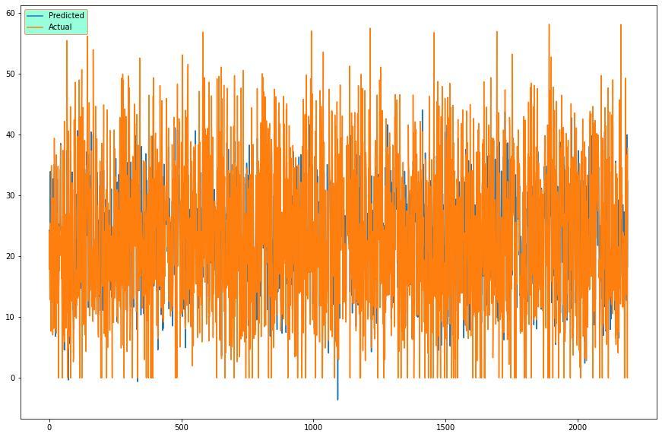
ELASTIC NET REGRESSION
MSE: 59.45120536350042
RMSE: 7.710460775044538
MAE: 5.873612334800099
R2: 0.6236465216363589
Adjusted R2: 0.6153885321484546
We Can Clearly See Our R2 Score Value Is 0.62 That Means Our Model Is Able To Capture Most Of The Data Variance. Let’s Save It In A Data Frame For Later Comparisons.

Slide 25
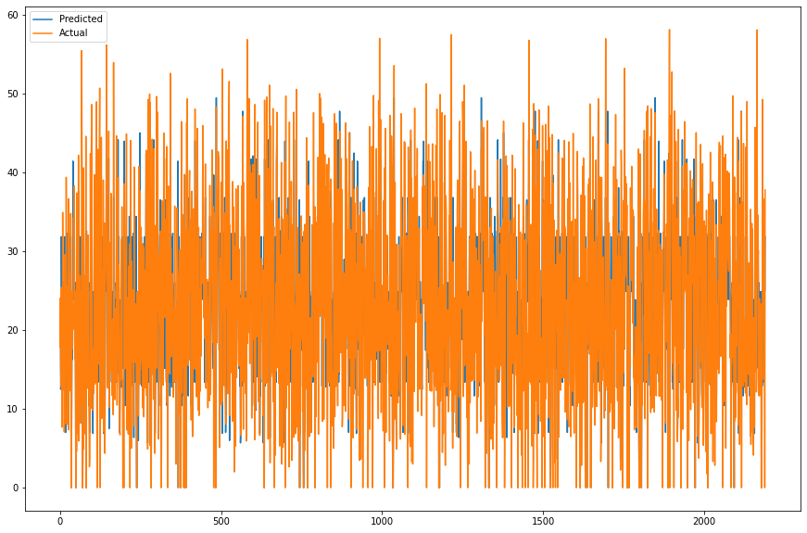
DECISION TREE
MSE: 78.6904140876056
RMSE: 8.870761753513934
MAE: 6.1922116004971075
R2: 0.5018534800990297
Adjusted R2: 0.49092309427487213
The R2_score For The Test Set Is 0.55. This Means Our Linear Model Is Performing Well On The Data. Let Us Try To Visualize Our Residuals And See If There Is Heteroscedasticity (Unequal Variance Or Scatter).

Slide 26
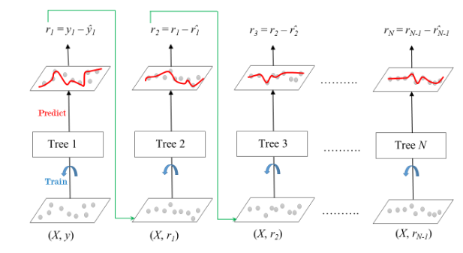
GRADIENT BOOSTING
MSE: 21.28944184250869
RMSE: 4.6140483138463875
MAE: 3.4928587865599914
R2: 0.8652280396863458
Adjusted R2: 0.8622708584843188
The R2_score For The Test Set Is 0.86. This Means Our Linear Model Is Performing Well On The Data. Let Us Try To Visualize Our Residuals And See If There Is Heteroscedasticity (Unequal Variance Or Scatter).

Slide 27
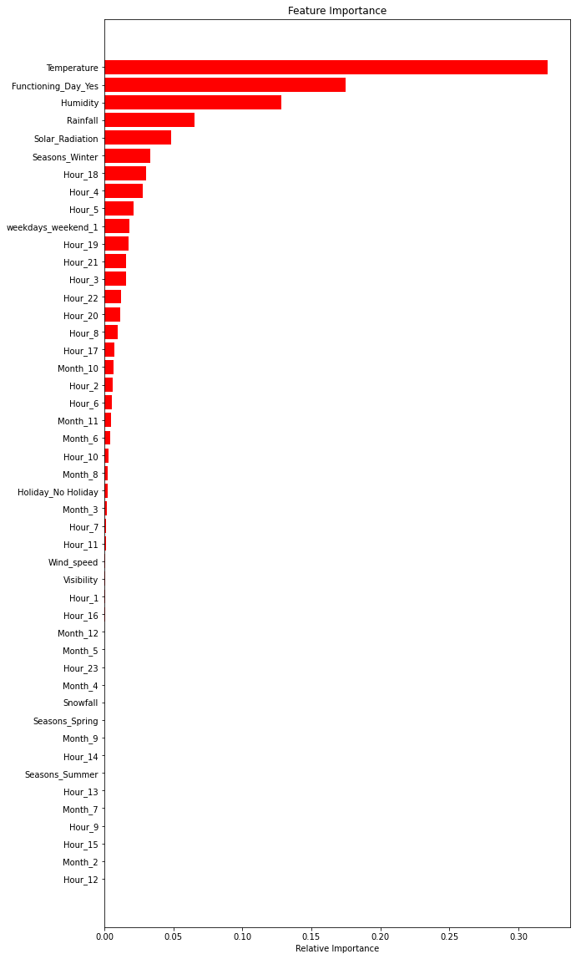
IMPORTANCE OF FEATURES

Slide 28
CONCLUSION
 |  | Model | MAE | MSE | RMSE | R2_score | Adjusted R2
Training set | 0 | Linear regression | 4.474 | 35.078 | 5.923 | 0.772 | 0.77
 | 1 | Lasso regression | 7.255 | 91.594 | 9.570 | 0.405 | 0.39
 | 2 | Ridge regression | 4.474 | 35.078 | 5.923 | 0.772 | 0.77
 | 3 | Elastic net regression | 5.792 | 57.574 | 7.588 | 0.626 | 0.62
 | 4 | Decision tree regression | 5.694 | 66.147 | 8.133 | 0.570 | 0.56
 | 5 | Random forest regression | 0.802 | 1.556 | 1.248 | 0.990 | 0.99
 | 6 | Gradient boosting regression | 3.269 | 18.648 | 4.318 | 0.879 | 0.88
 | 7 | Gradient Boosting gridsearchcv | 1.849 | 7.455 | 2.730 | 0.952 | 0.95
Test set | 0 | Linear regression | 4.410 | 33.275 | 5.768 | 0.789 | 0.78
 | 1 | Lasso regression | 7.456 | 96.775 | 9.837 | 0.387 | 0.37
 | 2 | Ridge regression | 4.410 | 33.277 | 5.769 | 0.789 | 0.78
 | 3 | Elastic net regression Test | 5.874 | 59.451 | 7.710 | 0.624 | 0.62
 | 4 | Decision tree regression | 6.192 | 78.690 | 8.871 | 0.502 | 0.49
 | 5 | Random forest regression | 2.201 | 12.669 | 3.559 | 0.920 | 0.92
 | 6 | Gradient boosting regression | 3.493 | 21.289 | 4.614 | 0.865 | 0.86
 | 7 | Gradient Boosting gridsearchcv | 2.401 | 12.393 | 3.520 | 0.922 | 0.92

Slide 29
CONCLUSION
The highest number of bike rents occur in summer while the least bike rents occur in winter.
Many bikes were rented on non-holiday
June is the busiest month, followed by july and may
Many customers would like to rent bike for 18 hrs followed by 17hrs and 19hrs
The number of rented bikes is huge, when there is solar radiation, the counter of rents is around 1000
The amount of rented bike is very low when we have more than 4 cm of snow, the bike rents is much lower
If it rains a lot the demand of rent bikes is not decreasing, here for example even if we have 20 mm of rain there is a big peak of rented bikes
Peoples love to ride bikes when its little windy.
The columns 'temperature', 'wind_speed','visibility','dew_point_temperature', 'solar_radiation' are positively relation to the target variable, which means the rented bike count increases with increase of these features.
Rainfall, snowfall, humidity these features are negatively related with the target variable which means the rented bike count decreases when these features increase.
Functioning day is the most influencing feature and temperature is at the second place for linear regressor.
Temperature is the most important feature for decision tree, random forest and gradient boosting regressor.
Random forest regressor and gradient boosting gridsearchcv gives the highest r2 score of 99% and 95% receptively for train set and 92% for test set. We can deploy this model.

